Slide 1
Principles of Finance
FIN200
Introduction
The Value of The Financial System

Slide 2
LEARNING OUTCOMES
Outline the character and importance of the main financial markets and instruments
Explain the key roles played in a modern society by the financial products, markets and institutions
Describe the relative standing of the major financial centres
Discuss the changes that have taken place in the way financial services are provided
Define and illustrate some key financial terms, such as primary market and over-the-counter.

Slide 3
Bond markets
Companies often need to borrow money
A bond, states that the company will
pay interest for, say, ten years and a capital sum at the end
Can sell it to other investors
Government bonds (UK government bonds are called gilts)
Corporate bonds.

Slide 4
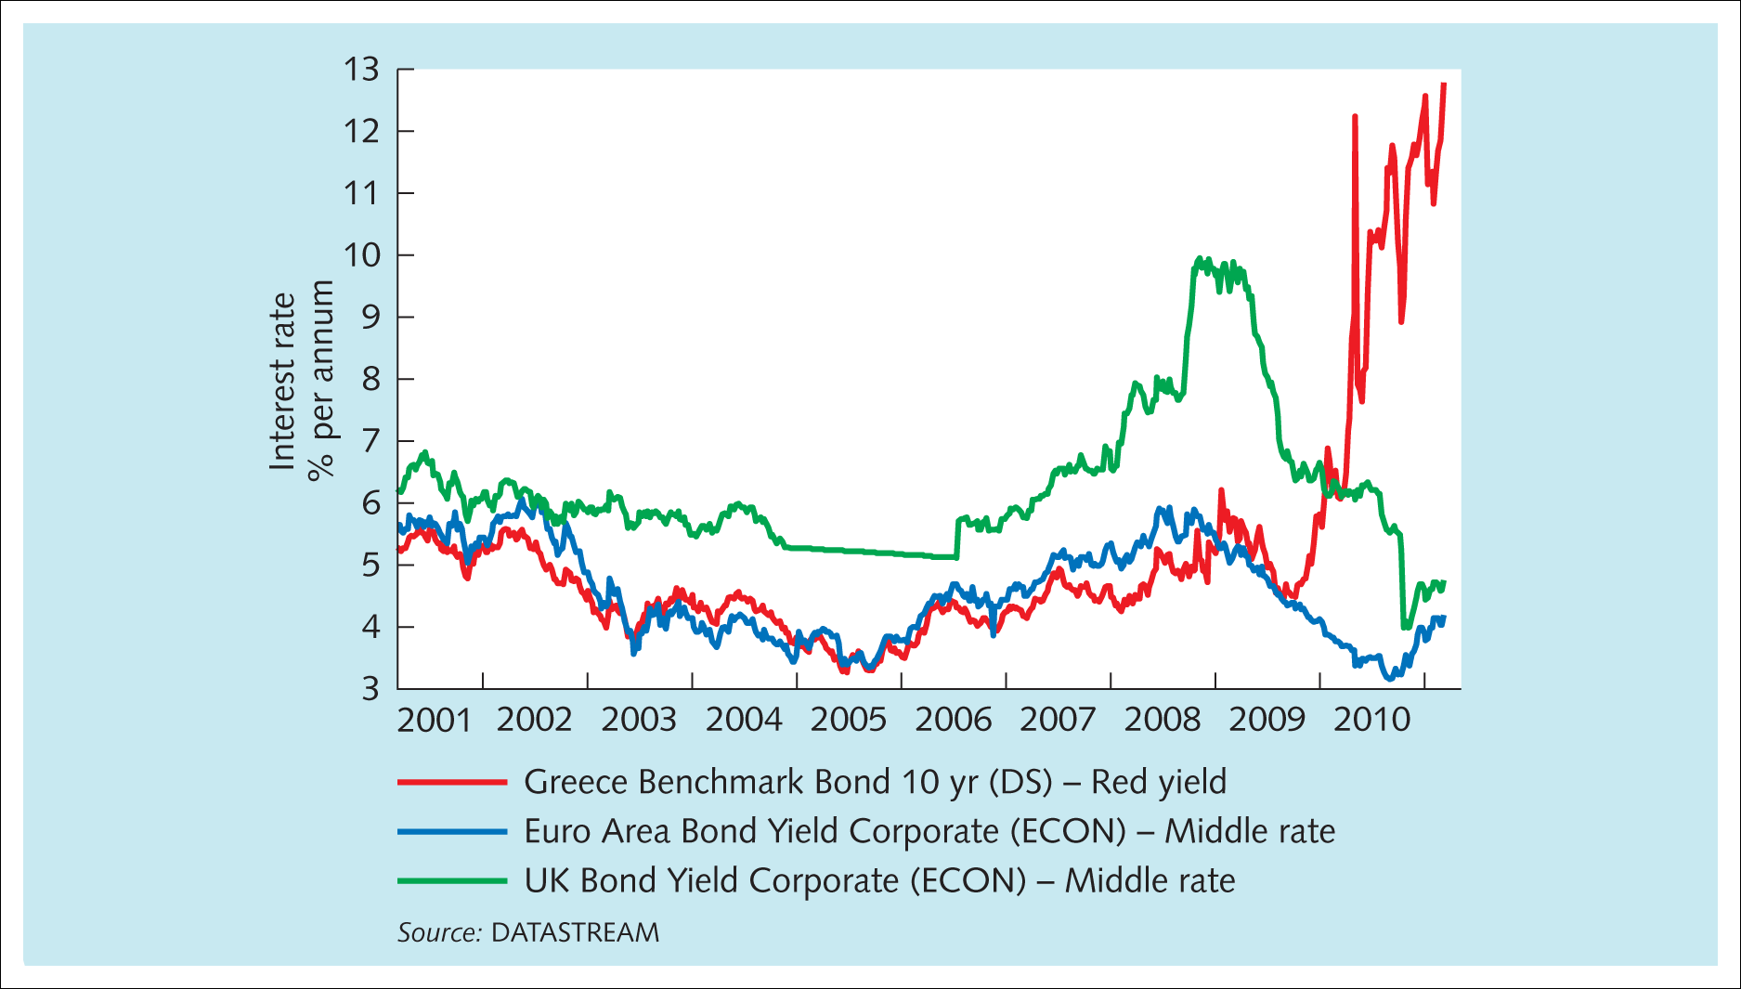
Exhibit 1.1 Yields on corporate bonds issued in pounds and euros, and yields on Greek government debt, 2001–2011
Source: Financial Times, 11 March 2011, p. 20. Reprinted with permission.

Slide 5
Equity markets
Limited liability for companies
Shares (also called equity and stock)
Owners of the company and can vote directors on or off the board to try to appoint a team
Share markets.

Slide 6
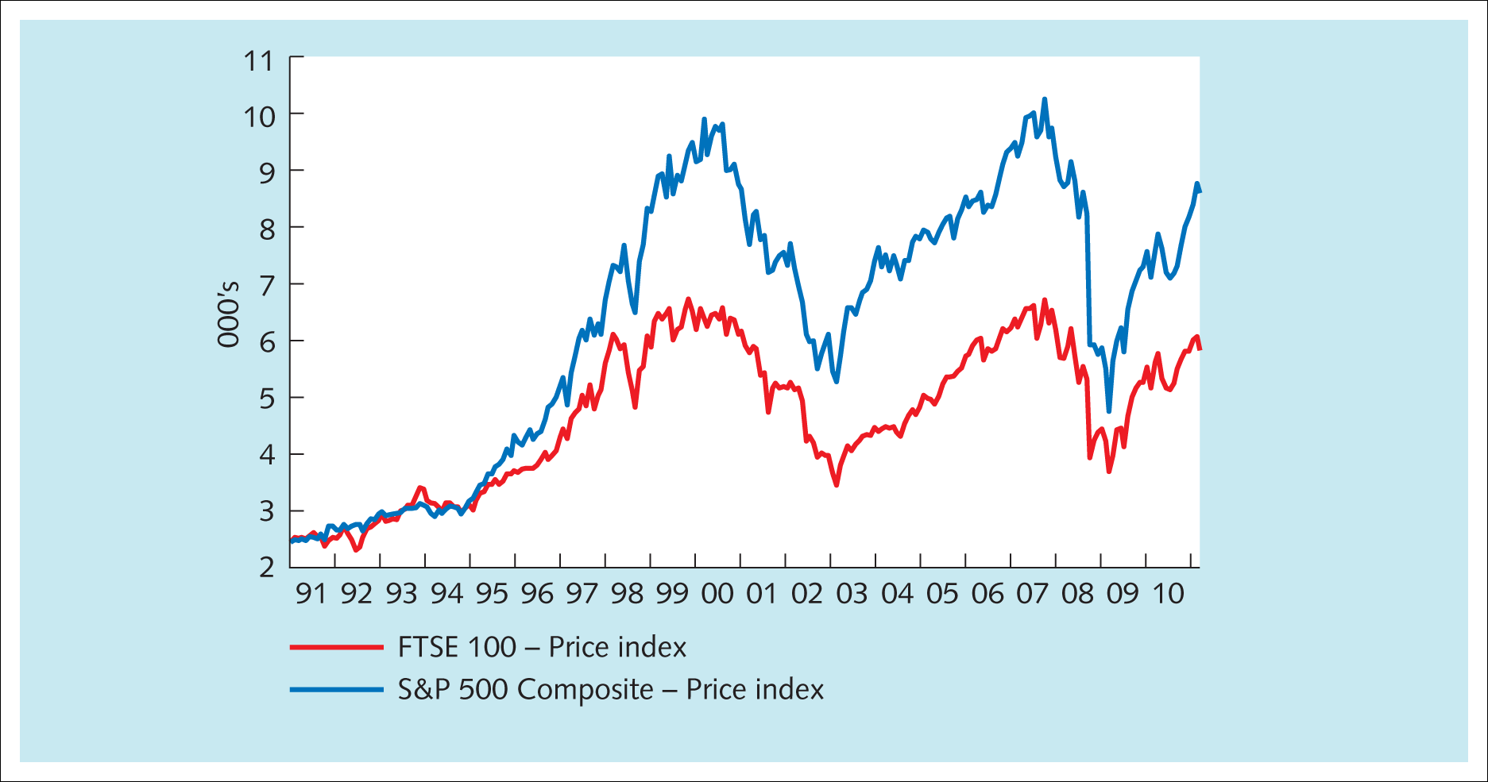
Exhibit 1.2 UK and US share market price movements, 1990–2011 (with the US S&P 500 index rebased to the UK FTSE 100 in 1991)
Source: DATASTREAM.

Slide 7
Money markets
Allow companies, etc. to issue instruments that promise to pay a sum of money after, say, 30 days if the buyer pays an amount now for owning that right
Wholesale markets
Borrowing for less than one year
Banks are particularly active
Large corporations, local government bodies and non-banking financial institutions also lend
Largest borrowers in these markets are usually governments
  Treasury bills.

Slide 8
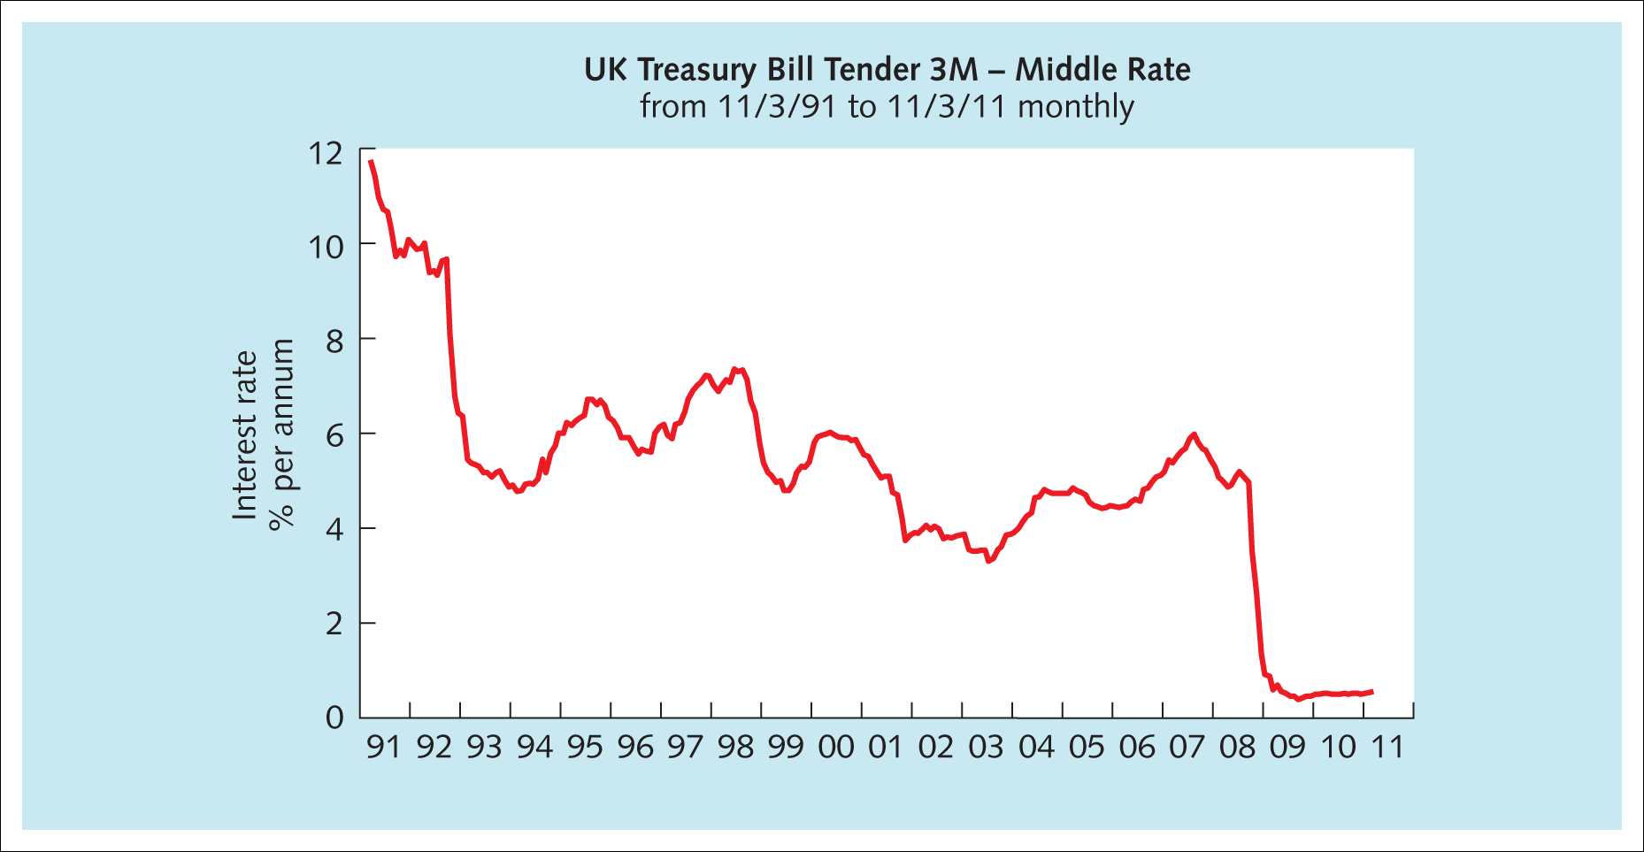
Exhibit 1.3 The interest rate the UK government offered investors in its various three-month Treasury bills issued each month 1991–2011
Source: DATASTREAM.

Slide 9
Foreign exchange markets
Manuel borrowed €300,000 to buy an apartment in London early in 2006
£1 for every €1.50, so he could buy a £200,000 apartment
In 2009 he needed to sell his apartment
At 2009 exchange rates (€1.10 to £1) he could obtain only €220,000
An €80,000 loss.

Slide 10
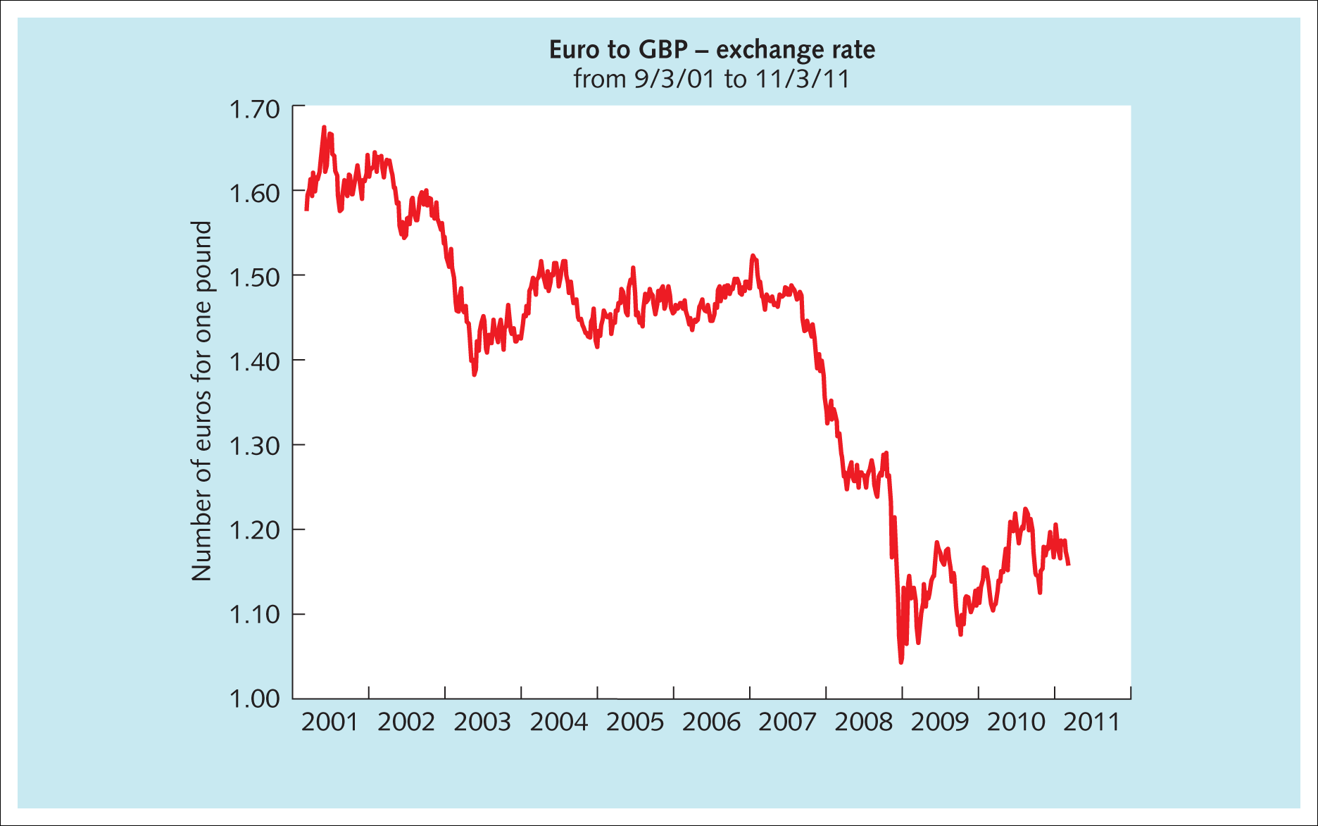
Exhibit 1.4 The exchange rate between euros and UK pounds, 2001–2011
Source: DATASTREAM.

Slide 11
Foreign exchange (forex, FX) markets
Markets in which one currency is exchanged for another
Spot market, currencies are bought and sold for ‘immediate’ delivery
Forward markets, the deal is agreed now to exchange currencies at some fixed point in the future
Futures and options and other forex derivatives are employed to hedge (manage) risk and to speculate.

Slide 12
Derivative and commodity markets
Cocoa farmer in Ghana
Cadbury would also like to know the cost of its cocoa six months from now
Perhaps the farmer could sell a future in cocoa at, say, $3,000 per tonne
A future is a contract to undertake a transaction (e.g. sell cocoa) at a point days, weeks or years from now, at a price agreed now.

Slide 13
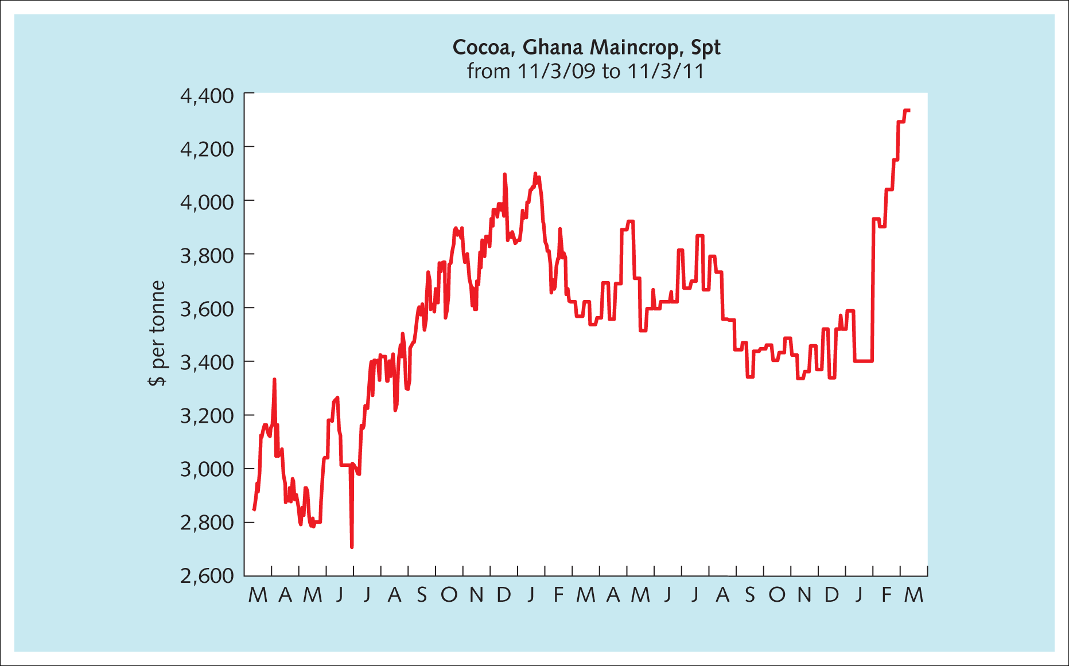
Exhibit 1.5 The futures price of cocoa, March 2009 to March 2011
Source: DATASTREAM.

Slide 14
A derivative
A financial instrument whose value is derived from the value of other financial securities or some other underlying asset because it grants a right to undertake a transaction
The right becomes a saleable derived financial instrument
An option gives the purchaser the right, but not the obligation, to buy or sell something at some point in the future, at a price agreed now.

Slide 15
Banking
Deposits
Providing loans
Allowing people and organisations to make payments to each other
Some borrowers may pose a low risk to the bank and so may be charged, say, 2 per cent over the base rate.

Slide 16
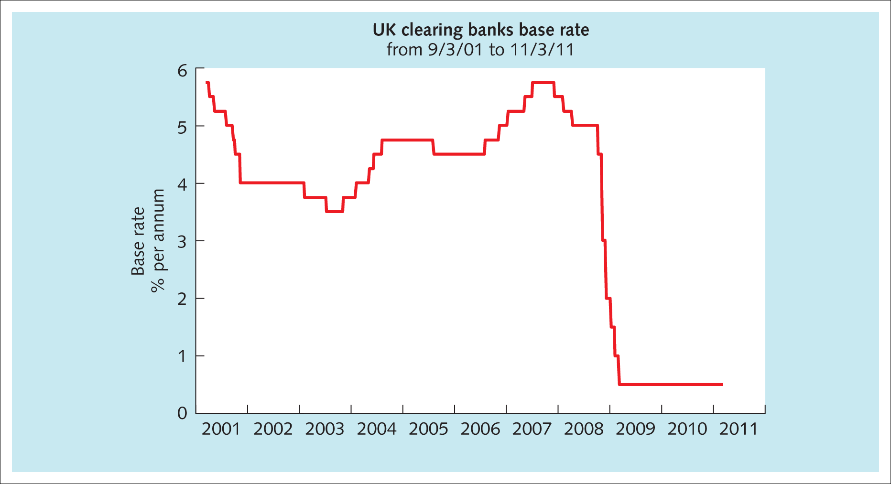
Exhibit 1.6 UK bank base rates, 2001–2011
Source: DATASTREAM.

Slide 17
Importance of different financial centres
The five groups of instrumental factors for judging the quality of a financial centre
People
Business environment
Market access
Infrastructure
General competitiveness.

Slide 18
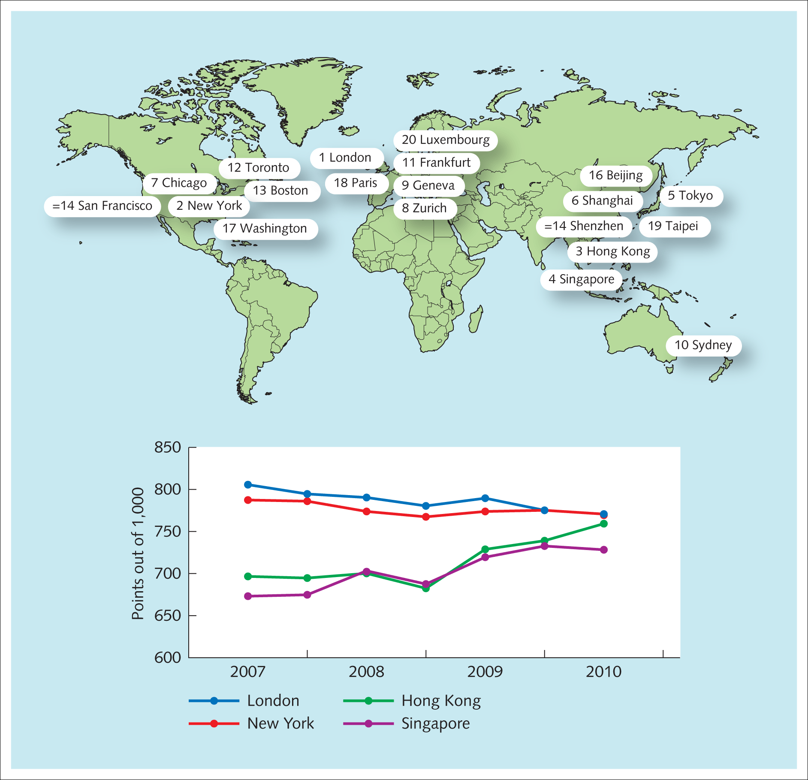
Exhibit 1.8 The top 20 global financial centres
Source: www.atlapedia.com.

Slide 19
Specific aspects of financial services
Asset management (e.g. mutual funds, unit trusts, pension funds):
  First – London
  Second – New York
  Third – Hong Kong
  Fourth – Singapore
Banking:
  First – New York
  Second – Hong Kong
  Third – London
  Fourth – Singapore.

Slide 20
Specific aspects of financial services (Continued)
Professional services (e.g. legal, accounting):
  First – London
  Second – New York
  Third – Hong Kong
  Fourth – Singapore
Wealth management (advice and investing for wealthy
people):
  First – London
  Second – Geneva
  Third – New York
  Fourth – Toronto.

Slide 21
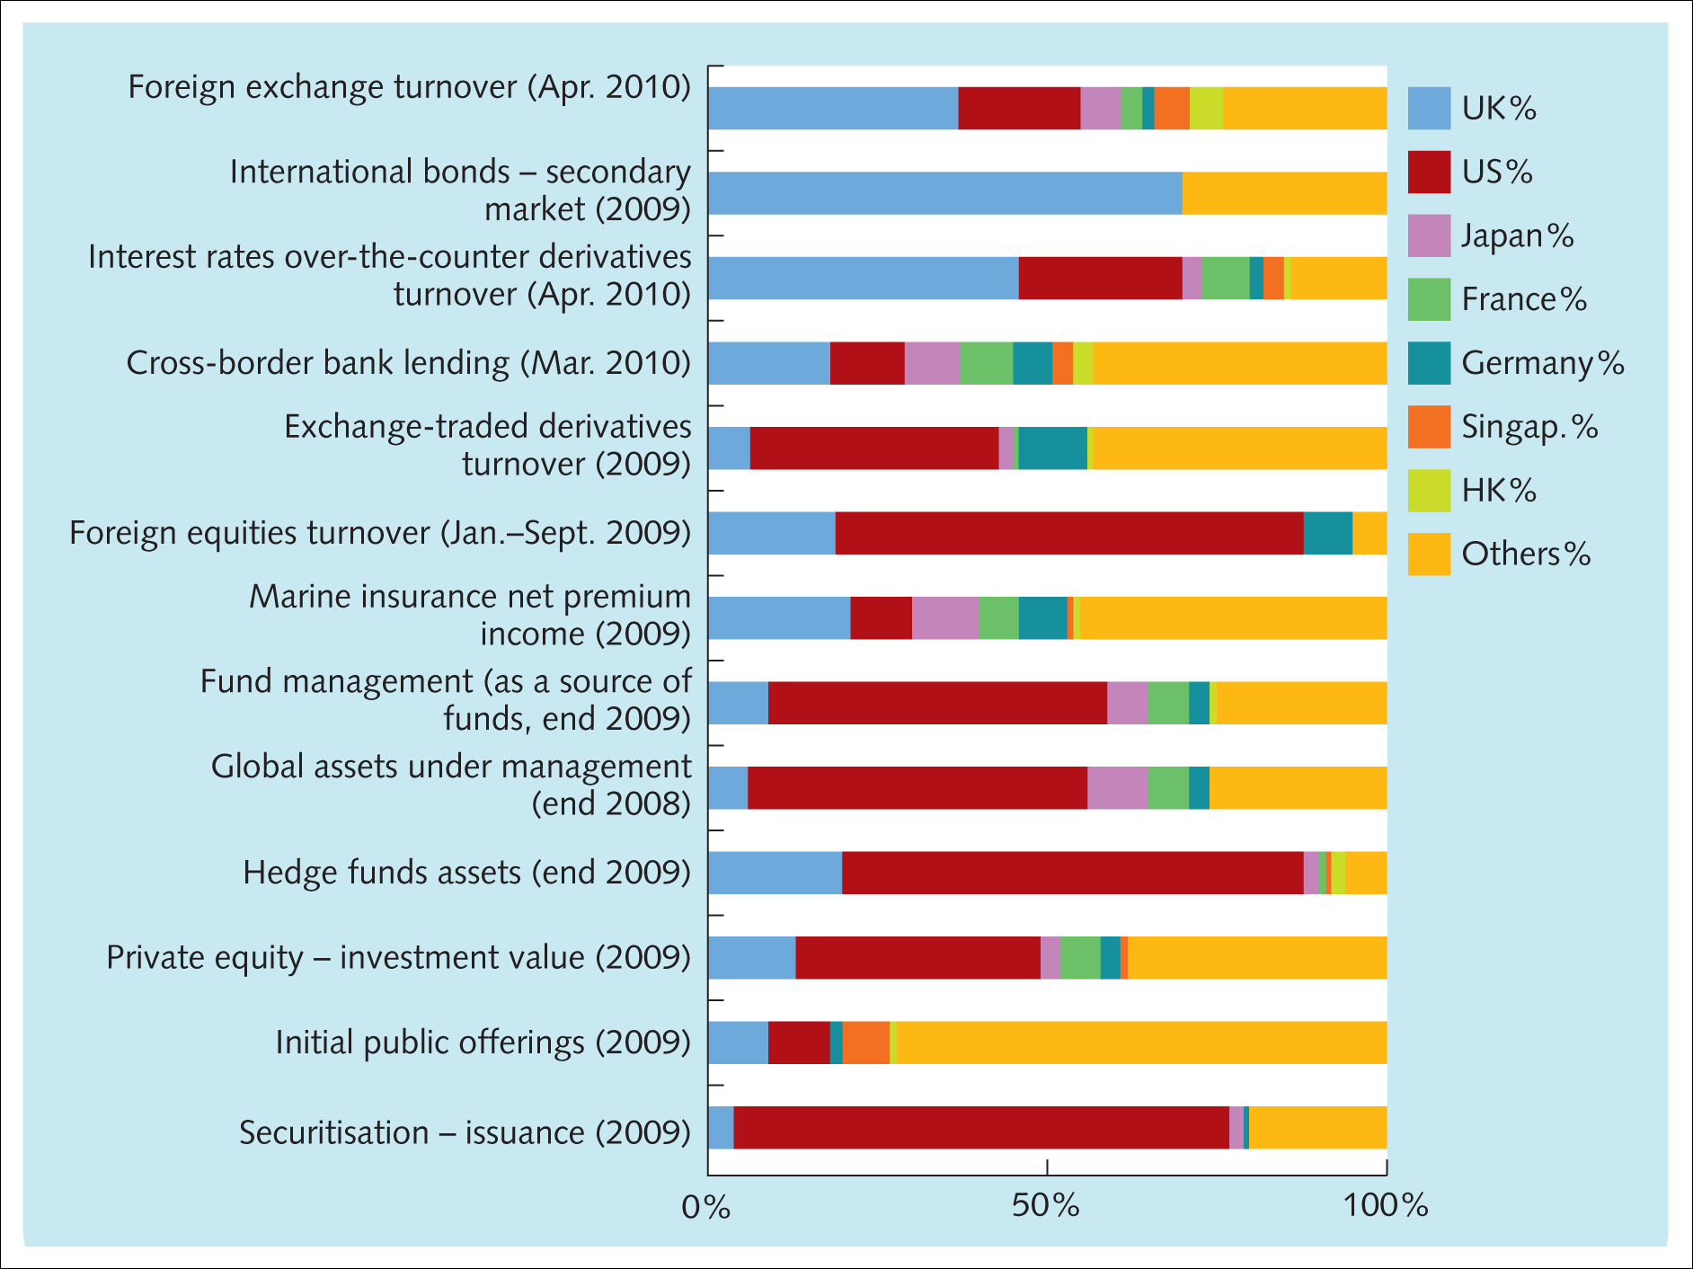
Exhibit 1.10 Share of world financial market activity
Source: TheCityUK estimates.

Slide 22
World without money or financial institutions
Barter-based system
Money
  Something into which all goods and services received can be converted
  Small and portable
  Hold its value over a long period of time
  General acceptability
Financial intermediaries
  Put lenders and borrowers in touch with each other
  Vast sums of money accumulated from various lenders.

Slide 23
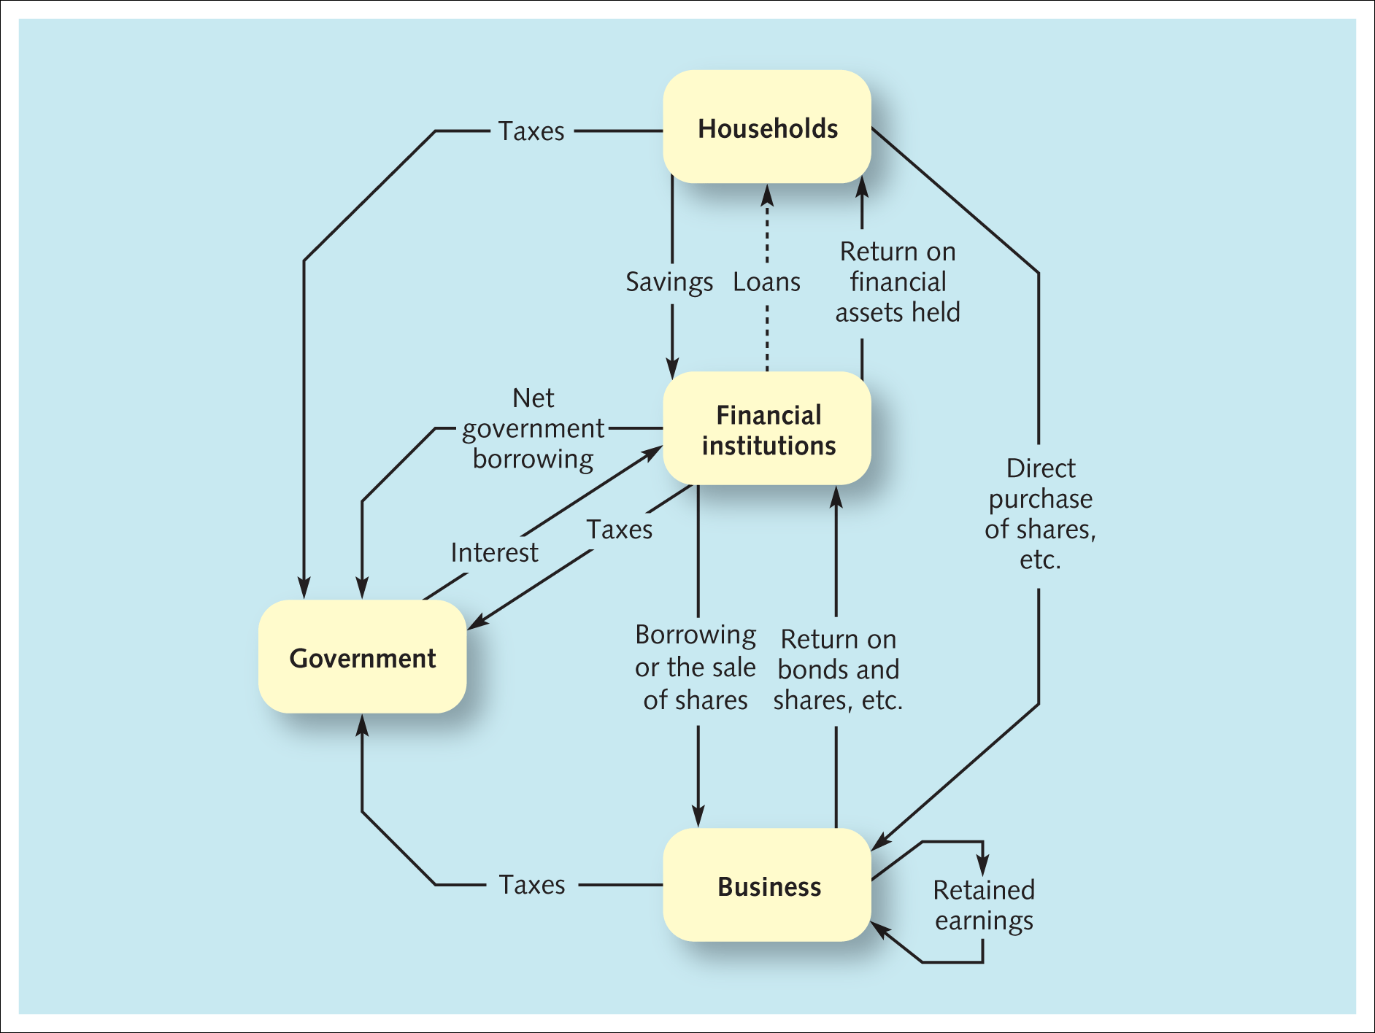
Exhibit 1.11 The flow of funds and financial intermediation

Slide 24
Financial intermediation
Primary investors
Ultimate borrowers
Conflict of preferences.

Slide 25
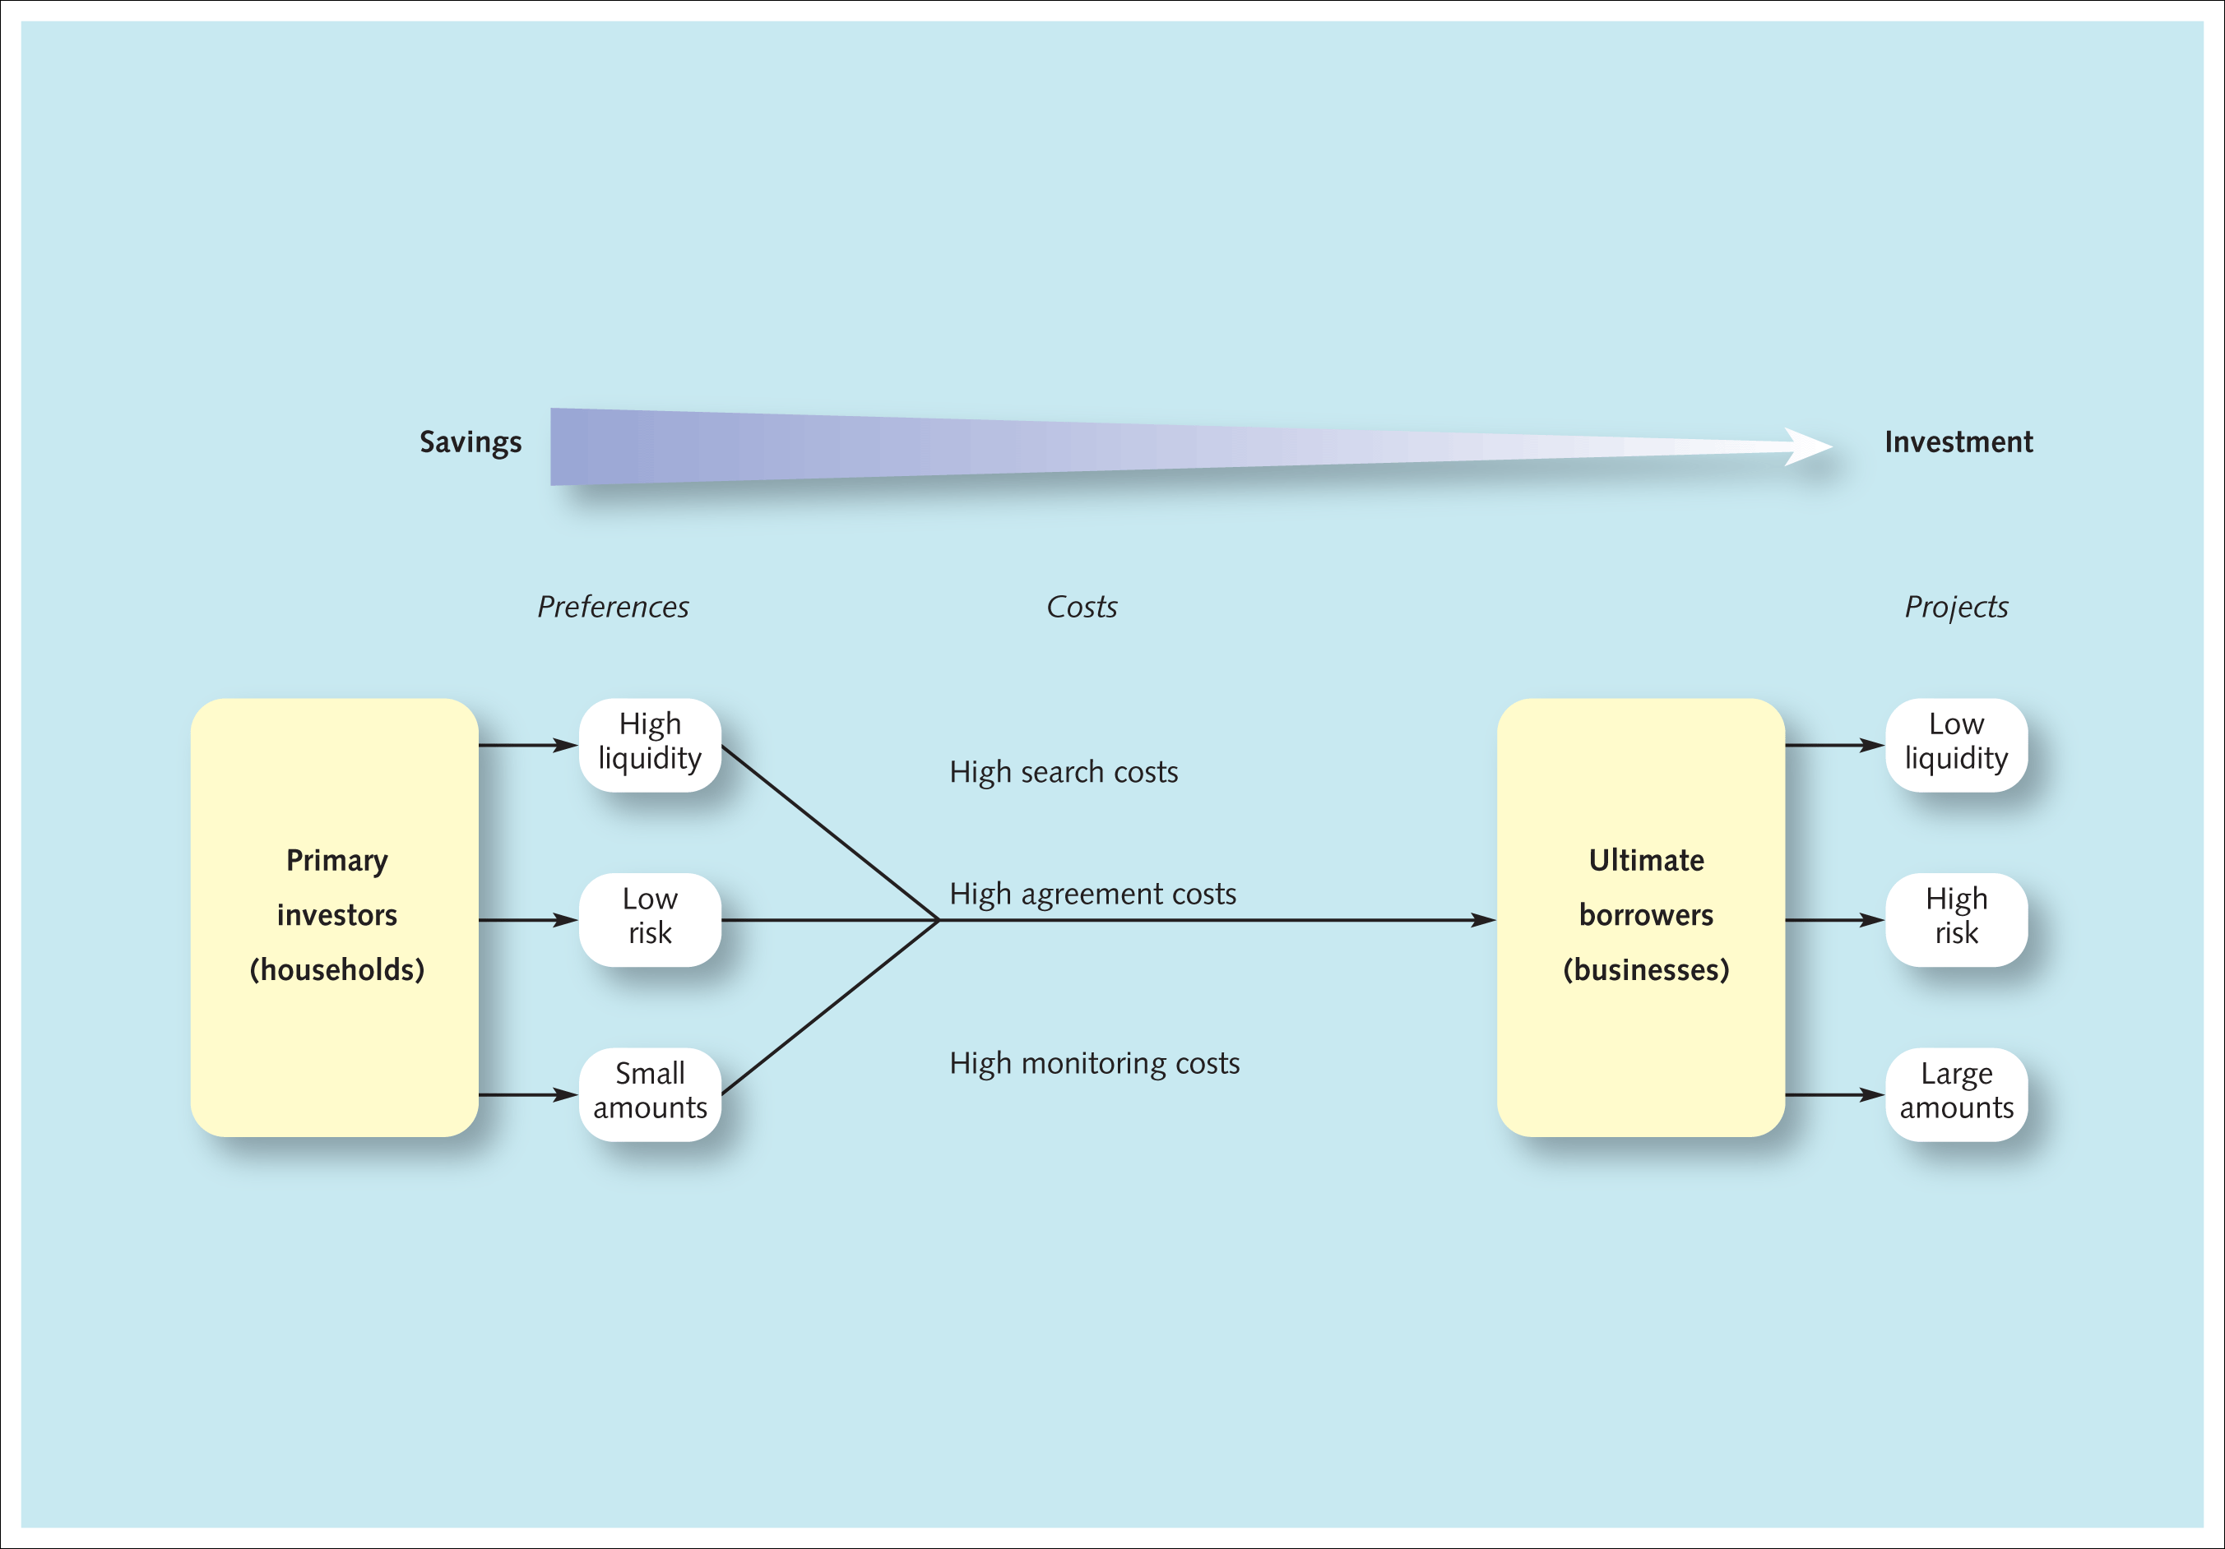
Exhibit 1.12 Savings into investment in an economy without financial intermediaries

Slide 26
The introduction of financial intermediaries
Brokers
Asset transformers
  Risk transformation
  Maturity (liquidity) transformation
  Volume transformation.

Slide 27
Intermediaries’ economies of scale
Efficiencies in gathering information on the riskiness of lending to a particular firm
Risk spreading
Transaction costs - search, agreement and monitoring costs.

Slide 28
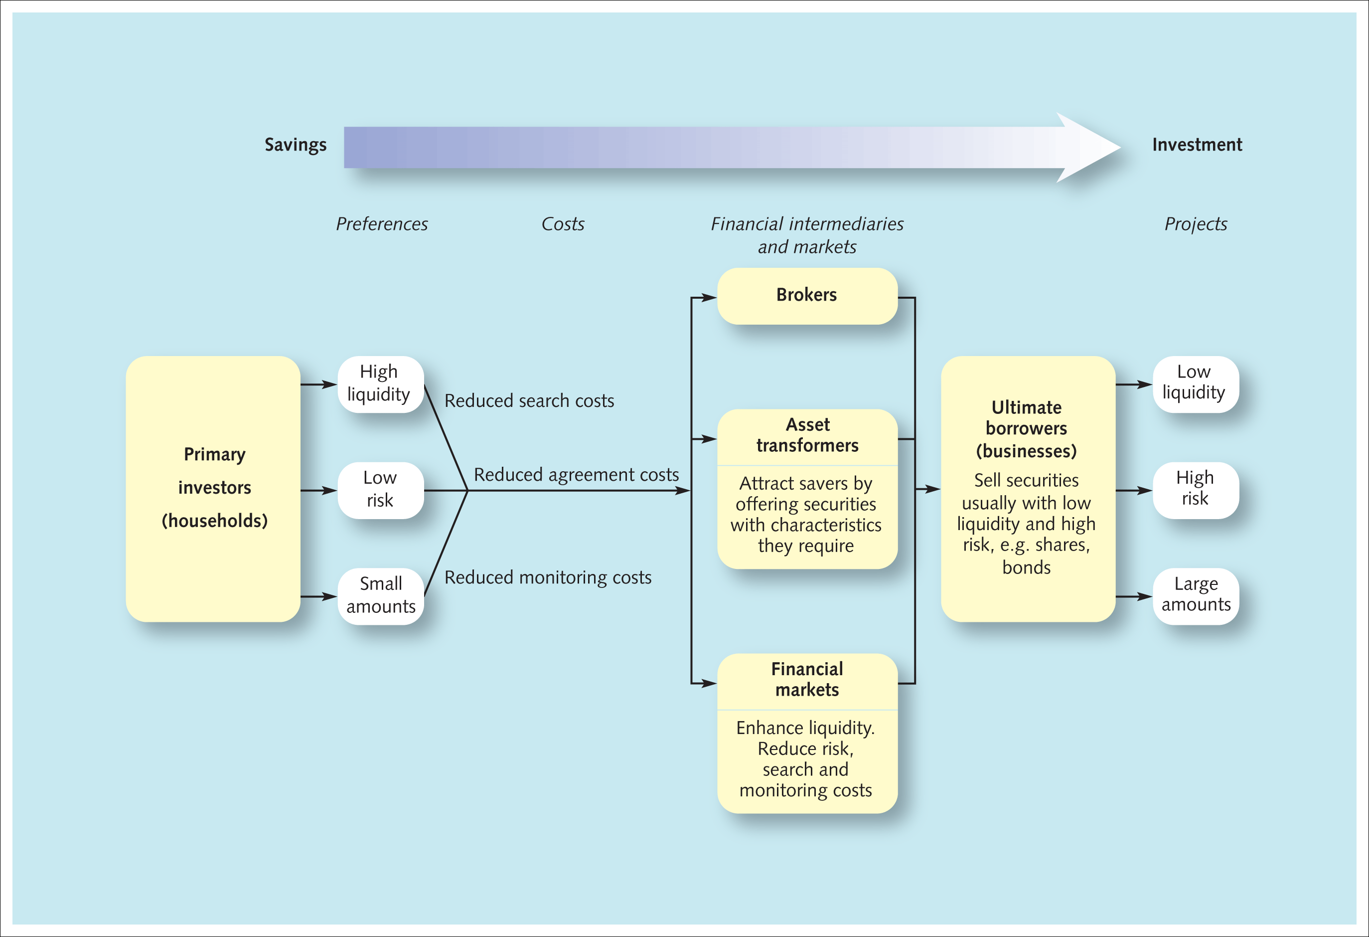
Exhibit 1.13 Saving into investment in an economy with financial intermediaries and financial markets

Slide 29
Financial markets
Primary market
Secondary market
Ability to liquidate (turn into cash) a holding
Reducing search, agreement and monitoring costs.

Slide 30
Growth in the financial services sector
London
Heart of the British Empire and the industrialised world
Open for business when the rest of Europe is active and when the Asian markets are still operating at the end of their trading day and the US is starting its working day
High income elasticity
International comparative advantage.

Slide 31
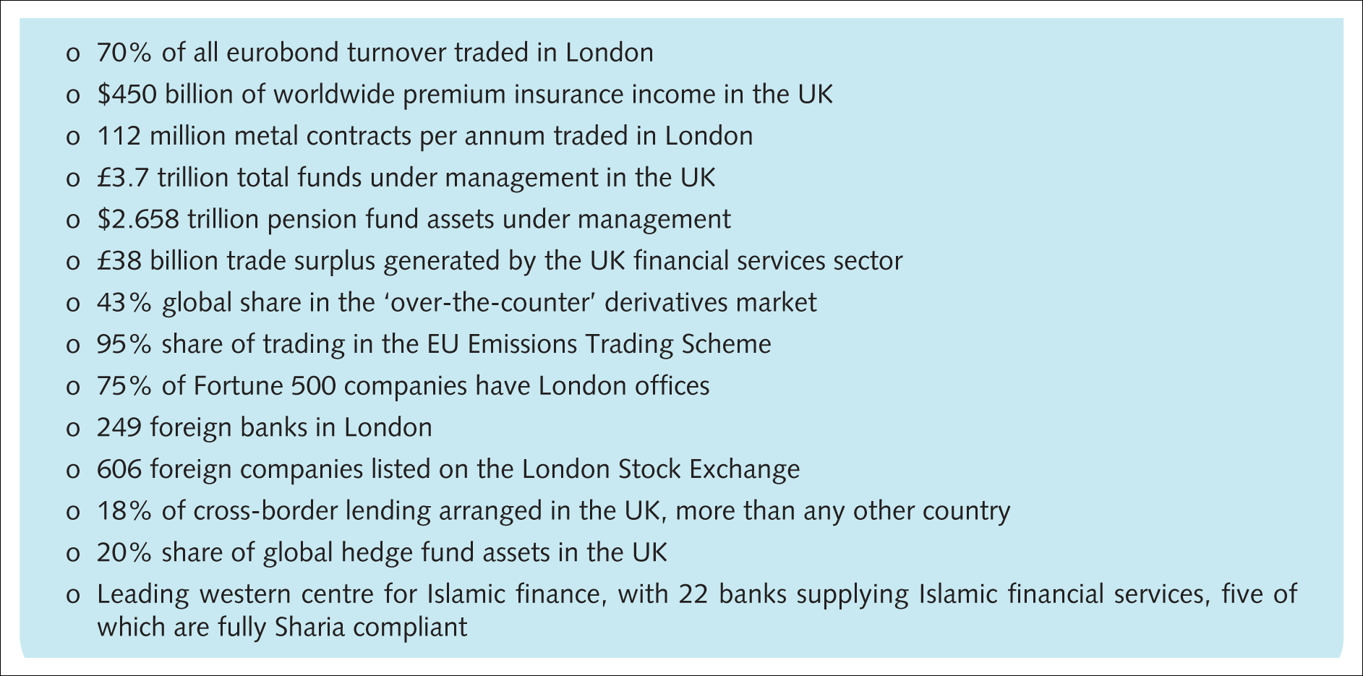
Exhibit 1.14 City of London’s position in international finance and business services
Source: www.cityoflondon.gov.uk, 2010.

Slide 32
Debt and equity capital
Borrow either by taking out loans or by issuing bonds
Interest being a tax-deductible expense
Bonds often traded in an active secondary market
Shares (equity)
Own part of the company
Returns in the form of dividends and capital gains
Shares offered a higher return to investors.

Slide 33
Exchange-traded and OTC markets
Exchange trading takes place on the myriad regulated share markets and other security exchanges
Publish prices
Funded by a mixture of commission on trades, admission fees and annual charges for listings
Over-the-counter (OTC) market, off-exchange market, trade in securities between two parties on a private basis
More risky
Little transparency in traded prices.

